Slide 1
Frequent Pattern Growth Algorithm(FP Growth)

Slide 2
Shortcomings Of Apriori Algorithm
Using Apriori needs a generation of candidate itemsets. These itemsets may be large in number if the itemset in the database is huge.
Apriori needs multiple scans of the database to check the support of each itemset generated and this leads to high costs.

Slide 3
Frequent Pattern Growth Algorithm
This algorithm is an improvement to the Apriori method.
A frequent pattern is generated without the need for candidate generation.
FP growth algorithm represents the database in the form of a tree called a frequent pattern tree or FP tree.
This tree structure will maintain the association between the itemsets.
The database is fragmented using one frequent item.
This fragmented part is called “pattern fragment”.
The itemsets of these fragmented patterns are analyzed.
Thus with this method, the search for frequent itemsets is reduced comparatively.

Slide 4
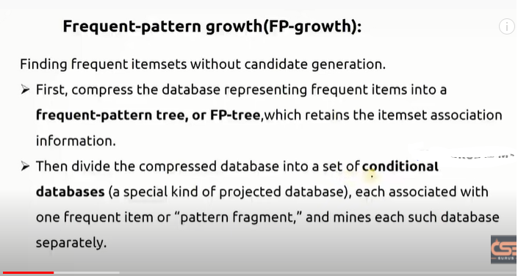

Slide 5
FP Tree
Frequent Pattern Tree is a tree-like structure that is made with the initial itemsets of the database.
The purpose of the FP tree is to mine the most frequent pattern. Each node of the FP tree represents an item of the itemset.
The root node represents null while the lower nodes represent the itemsets.
The association of the nodes with the lower nodes that is the itemsets with the other itemsets are maintained while forming the tree.

Slide 6
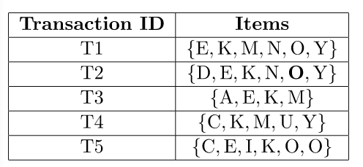
Example

Slide 7
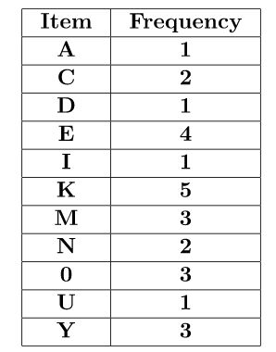
The frequency of each individual item

Slide 8
Let the minimum support be 3.
A Frequent Pattern set is built which will contain all the elements whose frequency is greater than or equal to the minimum support.
These elements are stored in descending order of their respective frequencies

Slide 9
Sort the itemset in descending order.
Item | Frequency
K | 5
E | 4
M | 3
O | 3
Y | 3

Slide 10
Now, for each transaction, the respective Ordered-Item set is built.
It is done by iterating the Frequent Pattern set and checking if the current item is contained in the transaction in question.
If the current item is contained, the item is inserted in the Ordered-Item set for the current transaction.

Slide 11
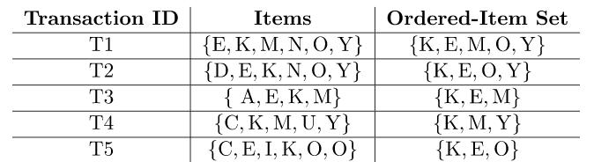
Ordered-Item set of each transaction

Slide 12
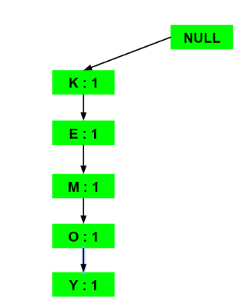
Fp tree construction: Considering the root node null. T1:{K, E, M, O, Y}

Slide 13
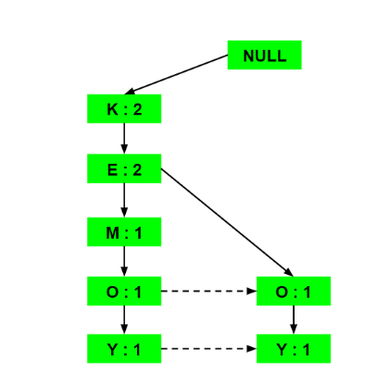
T2 : {K, E, O, Y}

Slide 14
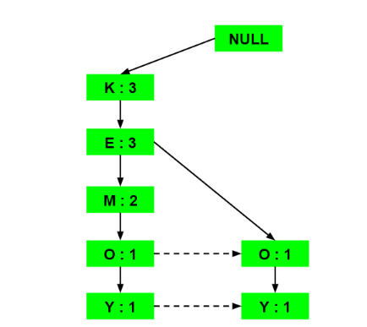
T3: {K, E, M}:

Slide 15
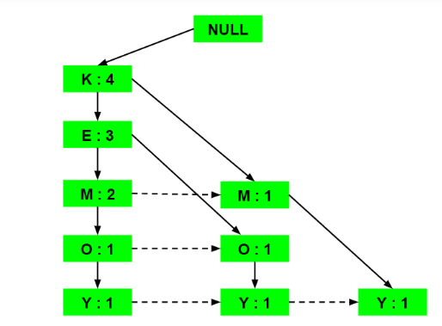
T4: {K, M, Y}:

Slide 16
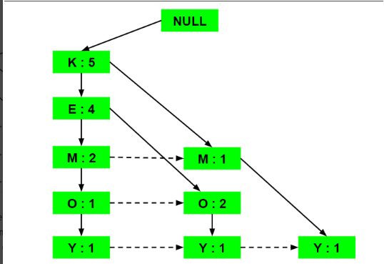
T5: {K, E, O}:

Slide 17
Conditional Pattern Base construction
Now, for each item, the Conditional Pattern Base is computed which is path labels of all the paths which lead to any node of the given item in the frequent-pattern tree.
Items are arranged in the ascending order of their frequencies.

Slide 18
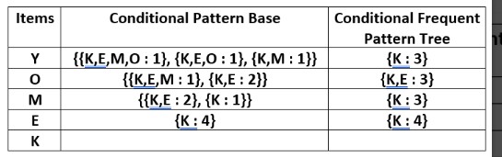
Conditional Pattern Base construction
Items | Conditional Pattern Base | Conditional FP Tree | Frequent patterns generarted
Y |  |  | {K,Y:3}
O |  |  | {K,O:3} ,{E,O:3},{K,E,O:3}
M |  |  | {K,M:3}
E |  |  | {E,K:4}
K

Slide 19
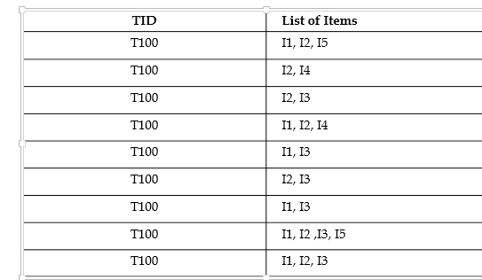

Slide 20
